Slide 1
Start to Finish: A Data Workflow in a Test Environment
Dr. Theodore Larson

Slide 2
Note: Webpage
You can access the files for this presentation and the powerpoint at
http://uco.theodorelarson.net

Slide 3
What are we trying to do?
Common Scenario: A colleague knows you do the data stuff, and sends you a file and says ‘data this, please’. You don’t know where the data came from, what it’s for, or where it’s going.
The problem: When we’re putting together a new solution, we don’t want to work on a ‘live’ system. One skill is being able to quickly create a test environment on a sandbox system.
Long-term, we’ll want polished, tested tools that will integrate with the existing environment. But short-term, we don’t know if this is a one-and-done, or if it’s part of a pattern of requests.

Slide 4
Workflow
One possible set of steps:
  Data Collection – Either provided or gathered
  Data Cleaning – The data is frequently messy, and we want it in an easily processed format.
  Database – We want to create a standard format for the data so that no matter what other forms it might take, it can go into the same system.
  Action – The data needs to have something done with it to be useful.
  Presentation – We either want a static image, a dynamic dashboard, or an app as our end result.
Presumption: It’s OK for us to have not much to show for it. We’re given a random request out of the blue. What we’re going to cover is where I’d expect a novice analyst to be able to get after 2-3 days.

Slide 5
ETL
What did this workflow sound like? The Extract – Transform – Load process.
  Extract – The data as it exists in its original format was possibly useful for the originator’s intentions. But we likely have different goals, so we want to pull the data out into a live data structure for further manipulation.
    Alternately, it has gone through so many hands that there isn’t a lot of coherence to it.
  Transform – That live data structure is only feasible as long as a program is running. Likely, we’ll want to have it in a standardized format of some sort.
    ‘Standardized’ in this case may just mean a standard we create on the spot, going forward.
  Load – Once the data is in a semi-static state, we want to be able to manipulate it to gain insights into what it is telling us.

Slide 6
Agile Method / Sandboxing
One principle I like to use is an agile method. Simplified, it means that we’re going to have a useable end result at the end of every day. It will become more utile as time goes on, but we at least have something.
This sandbox approach will let us cut some corners at first, just to get to a usable state. This is not a long-term viable solution. But, frequently, we don’t know whether we’re on a long-term project, so as long as we are aware we’re cutting corners, and we document it, it’s ok.
Golden Rule: We can do what we like, as long as we document everything.

Slide 7
Tools
First step is to select the tools. We need:
  A Procedural Programming Language – Python is a standard choice for this. We can download it at python.org, 3.10.0 at the current moment.
  A Database Utility – Since it’s a sandbox, we’ll stick with open source and download XAMPP from apachefriends.org, 8.0.12 at the current moment.
  A Presentation Tool – For the sake of teaching, we’ll stick with open source, and create a quick website that interfaces with the data. XAMPP will let us run an apache server and develop the interface tool in HTML and PHP.

Slide 8
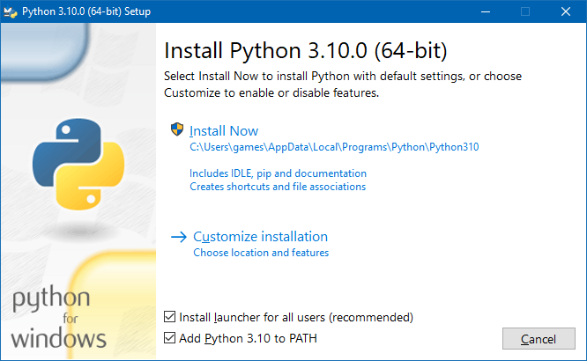
Python
Download and run the executable
Infosec note: This is only really feasible in our sandbox environment since we’ll control admin rights, we are disconnected from any sensitive information, and we’re likely to wipe the whole sandbox when we’re done.

Slide 9
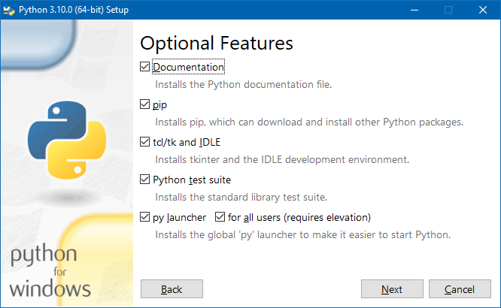
Python, cont.
Likely, we’ll want all of the optional features, documentation, package managers, etc. We won’t use any packages in this project, because installing and managing them is a separate lecture. But it’s a fairly standard process.

Slide 10
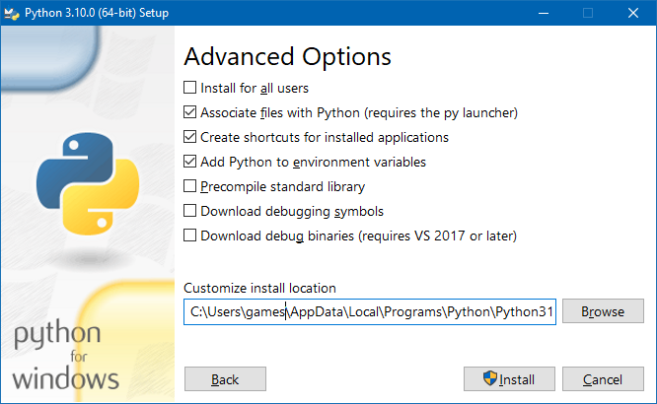
Python, cont.
Don’t install for all users, that’s typically more admin than is worthwhile in this environment.
We want to associate with Pythong, create shortcuts, and add the environment variables.
  This part means some of python will never get uninstalled, but that’s difficult to get around.
We don’t need any debugging tools.

Slide 11
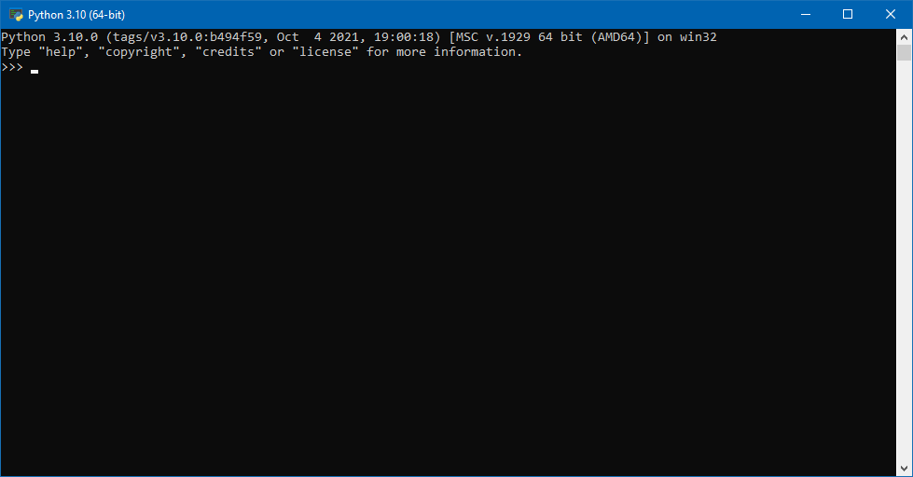
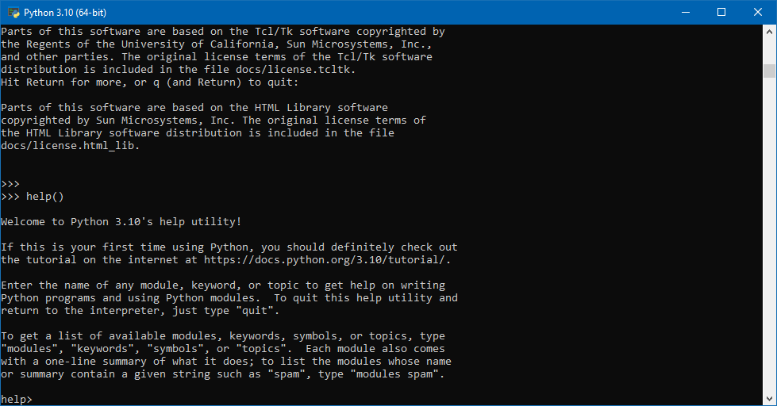
Python, cont.
Continuing will drop us on a basic command prompt.
Help() will get us to a help prompt to go through getting started, and points us towards https://docs.python.org/3.10/tutorial/ for our API.
  Experienced programmers always have an API open in the background. It’s better to confirm functions and arguments than to try to remember them.
I also recommend at least cycling through the license(), if you use Python regularly.
  Most people get by without ever having done so. But for tools of routine use, having at least skimmed it seems necessary for business students.

Slide 12
Data Cleaning
The original file was sent in word, but we don’t want the extra word cruft, so we cut/paste it into a text document.
  In reality, this comes from a student’s submission of an XML document, so I’m avoiding any PII in the metadata.
Notice that there are glaring errors in the formatting and structure of the data.
It’s XML, why? Who knows, I get sent data all the time in random formats from someone who got it from someone who got it from someone. Identifying the format is convenient, but not necessary. XML is tricky, in particular, because most people forget the <?xml version=1.0> at the beginning.
2006-2011 NYS Math Test Results by Grades 8th Graders
Grade Year Category Number Tested Mean Scale Score
<Students Tested>
<Row>
<Grade>
8
</Grade>
<Year>
2006
</Year>
<Category>
Asian
</Category>
<Number Tested>
9593
</Number Tested>
<Mean Scale Score>
675
</Mean Scale Score>
</Row>
<Row>
<Grade>
8
</Grade>
<Year>
2007
</Year>
<Category>
Asian
</Category>

Slide 13
Data Cleaning – Step 1
First, remove the two header lines, we don’t know where they came from. They might be handy, but they mostly repeat what’s in the data.
Second, remove extra spaces from tag names.
  Find/replace is the easiest tool here.
Third, add tabs and CRs to make it fit a standard structure.
  This I prefer to do manually, particularly on something short like this. It should take 3-5 minutes and helps you familiarize yourself with the data.
<StudentsTested>
<Row>
<Grade>
8
</Grade>
<Year>
2006
</Year>
<Category>
Asian
</Category>
<NumberTested>
9593
</NumberTested>
<MeanScaleScore>
675
</MeanScaleScore>
</Row>
<Row>
<Grade>
8
</Grade>
<Year>
2007
</Year>
<Category>
Asian
</Category>
<NumberTested>
9734
</NumberTested>

Slide 14
Data Cleaning – Gut Check
What do we see in the data as we cleaned it? Is there anything anomalous?
In this case, no. But this is the sort of thing we look for:
  Q: Why is everything listed as Grade 8? A: Obviously someone filtered the data at some point before it got to us. We don’t want to just avoid that attribute, as we may need it again in the future and it takes almost as much effort to remove as to keep.
  Q: Why are White/Asian students only tested at ~10k/yr, but Black and Hispanic students are tested at ~20k-25k/yr? A: These are the sort of disparities we’re looking for, but since we can easily imagine a district that’s a 15%/15%/30%/40% mix, respectively, that’s not an anomaly.

Slide 15
Data Cleaning – Step 2
One last thing to consider: Tag/Attribute names. Clarity and descriptiveness are important.
  ‘Row’ is implicit in its position. Let’s change it to something more descriptive like ‘StudentGroup’.
  ‘Category’ is vague in its meaning. It may also be a little dehumanizing in application to people. A more descriptive ‘Race’ attribute name is more applicable.
<StudentsTested>
<StudentGroup>
<Grade>
8
</Grade>
<Year>
2006
</Year>
<Race>
Asian
</Race>
<NumberTested>
9593
</NumberTested>
<MeanScaleScore>
675
</MeanScaleScore>
</StudentGroup>
<StudentGroup>
<Grade>
8
</Grade>
<Year>
2007
</Year>
<Race>
Asian
</Race>
<NumberTested>
9734
</NumberTested>

Slide 16
Python – Data Extraction Step 1
IDLE is a convenient editor that comes with Python. We’ll use it for now.
  I prefer the windows default notepad.exe, but Sublime Text and Notepad++ are both excellent advanced text editors with IDE features.
First code iteration
  Import sys so that we can use sys.exit(0) and close properly.
  We’ll define the file location as the locale directory and then the location of the data we cleaned.
  Opening a file in python is a routine, core task so we simply use the open() function and tell it to handle it as a read-only file.
  We need to close() the file before we close the program.
    Python will probably handle it for us. But some blocking tasks like file access are better done explicitly.
import sys
xmlFileLocation = '.\\OriginalXML-Step2.txt'
xmlFileHandle = open(xmlFileLocation, 'r')
xmlFileHandle.close()
sys.exit(0)

Slide 17
Python – Data Extraction Step 2
Once we have a file open, we have several ways to read it.
  Since we know that the data is line based, in this case we can do a line by line approach using filehandle.readline(), which stores the results in a List of Strings
  The more robust approach, later, would likely involve taking it as a single monolithic string and scanning for paired <>’s to identify tag names.
Just for self-edification, I like to include a check at every step. I added a command to read the lines of a file. Can I immediately output those lines to the screen?
  Print() will output directly to the python console.
  For … in … is a nice control structure in python. Rather than define the for-loop ourselves, we can just tell us ‘handle this in the best way possible, and let me iterate over every element in a collection’.
import sys
xmlFileLocation = '.\\OriginalXML-Step2.txt'
xmlFileHandle = open(xmlFileLocation, 'r')
xmlLines = xmlFileHandle.readlines()
for line in xmlLines:
print(line)
xmlFileHandle.close()
sys.exit(0)

Slide 18
Python – Data Extract Step 3
Before we move onto the next step, a couple of guidelines.
Using the agile method, we want to get to a finished project as quickly as possible, this sometimes includes the use of nonsensical shortcuts.
In this case, our shortcut is ‘we know the input format, let’s just hardcode that format exactly’, which defeats the purpose of a programmatic solution.
We need to add notes to remind ourselves later that this was a shortcut that needs a better resolution.
This is a development practice, not a final product practice. Over the course of weeks, it would not be acceptable. Over the course of hours, it may be reasonable.

Slide 19
Python – Data Extract Step 3
At this point, we’ve crossed into a point where adding comments is important. That should always happen early.
A List in python can have the last element removed with the .pop() function. We’ll use that on our list of strings from the file.
  Why not process it in order? Because when we delete the last element, we just delete the last element. When we delete the first element, we delete the first element and then reorder the entire list. Not a problem here, but also not a good general practice.
The target data structure is a list of lists. This is not a true matrix. Longer term, we’d likely want a matrix data structure, but we’re avoiding importing packages for the sake of this lesson.
We know the structure, so we’re going to discard the framework and pull out the data.
  Note: We aren’t editing the original data, so we can freely discard anything we want.
The while loop is bad form, but we already have a revision of this section scheduled.
We’ll reverse the attributes as they come in, and then reverse the lines at the end, to make sure we conform to the standard.
# TODO: Add Code to identify tags and structure, generalize format
xmlLines.pop() # </StudentsTested>
xmlMatrix = []
while len(xmlLines) > 1:
xmlLines.pop() # </StudentGroup>
xmlLines.pop() # </MeanScaleScore>
StudentGroup = [xmlLines.pop()]
xmlLines.pop() # <MeanScaleScore>
xmlLines.pop() # </NumberTested>
StudentGroup.append(xmlLines.pop())
xmlLines.pop() # <NumberTested>
xmlLines.pop() # </Race>
StudentGroup.append(xmlLines.pop())
xmlLines.pop() # <Race>
xmlLines.pop() # </Year>
StudentGroup.append(xmlLines.pop())
xmlLines.pop() # <Year>
xmlLines.pop() # </Grade>
StudentGroup.append(xmlLines.pop())
xmlLines.pop() # <Grade>
xmlLines.pop() # <StudenntGroup>
StudentGroup.reverse()
xmlMatrix.append(StudentGroup)
xmlMatrix.reverse() # It doesn't matter, since the data wasn't ordered, but it doesn't hurt
print(xmlMatrix)

Slide 20
Python – Data Extract Step 4
Currently, we have a set of strings, but mixed in are formatting characters, we need to get rid of them.
  There are several useful functions, for example strip() likely does what we want, but frankly, I forgot that it existed until after I’d written out all of this code.
  An object lesson in the idea that there’s always multiple ways to code a given task, some are objectively better than others, and trying to remember everything all the time will frequently fail you.
Numbers are better as actual numbers. If we use the int() function, we are casting the string as numbers.
  There’s a whole missing step here, we ought to be checking to be sure, programmatically, that we can do this before we do. But, for now, we’re trying to get to a working result as quickly as possible.
xmlLines.pop() # </StudentsTested>
xmlMatrix = []
while len(xmlLines) > 1:
xmlLines.pop() # </StudentGroup>
xmlLines.pop() # </MeanScaleScore>
StudentGroup = [xmlLines.pop().strip('\t\n')]
xmlLines.pop() # <MeanScaleScore>
xmlLines.pop() # </NumberTested>
…
StudentGroup.append(xmlLines.pop().strip('\t\n'))
xmlLines.pop() # <Grade>
xmlLines.pop() # <StudentGroup>
StudentGroup.reverse()
xmlMatrix.append(StudentGroup)
xmlMatrix.reverse() # It doesn't matter, since the data wasn't ordered, but it doesn't hurt
for StudentGroup in xmlMatrix:
StudentGroup[0] = int(StudentGroup[0])
StudentGroup[1] = int(StudentGroup[1])
StudentGroup[3] = int(StudentGroup[3])
StudentGroup[4] = int(StudentGroup[4])
# Close file
xmlFileHandle.close()

Slide 21
Python – Data Transform Step 4
Same file, same step
Since we have the data as a data structure, we’ve arguably finished the extract stage and are moving onto the transform stage.
  Just like anything else, clean cuts from one stage to the other aren’t objectively defined.
  ‘Transform’ frequently implies some of what we did during the cleaning stage, and more intense altering of structure and metadata.
We’re acting in reverse of our initial file read. We’re creating lines one-by-one, and storing them as a list of strings.
# Close file
xmlFileHandle.close()
#Construct SQL Query
sqlLines = ["CREATE DATABASE StudentsTested;"]
sqlLines.append("DROP TABLE StudentGroup;")
sqlLines.append("CREATE TABLE StudentGroup (Grade int, Year int, Race varchar(255), NumberTested int, MeanScaleScore int);")
# We could do this more efficiently with fewer insert statements, but this is clearer for now
for StudentGroup in xmlMatrix:
sqlLines.append("INSERT INTO StudentGroup VALUES ("
+ str(StudentGroup[0]) + ", "
+ str(StudentGroup[1]) + ", "
+ "\'" + StudentGroup[2] + "\', "
+ str(StudentGroup[3]) + ", "
+ str(StudentGroup[4]) + ");")
print(sqlLines)
#exit
sys.exit(0)

Slide 22
Python – Data Transform Step 5
A quick and easy extraction is pulling some of the metadata out into their own variables. This changes nothing in execution, since most languages would even undo this stage during compilation. But it reminds us that we should be generating those strings from the datafile, not manually assigning them.
  A potentially better format would be (AttributeName, datatype), but we aren’t going to get into tuples or datatypes as variables, yet.
  One other silly issue: coding conventions change over time and between languages. It’s not important, per se. But it’s better to be up to date than not. The difference between ‘ and “ marks is not accurate in this code. Current convention suggests the SQL code should be delimited by ‘ and the file location at the top delimited by “.
Please note how unashamed I am of making small mistakes. The solution? Just fix it. Get good at finding your own mistakes.
# Close file
xmlFileHandle.close()
#Construct SQL Query
sqlLines = ["CREATE DATABASE " + DatabaseName + ";"]
sqlLines.append("DROP TABLE " + TableName +";")
sqlLines.append("CREATE TABLE " + TableName + " ("
+ Attributes[0] + " int, "
+ Attributes[1] + " int, "
+ Attributes[2] + " varchar(255), "
+ Attributes[3] + " int, "
+ Attributes[4] + " int);")
# We could do this more efficiently with fewer insert statements, but this is clearer for now
for StudentGroup in xmlMatrix:
sqlLines.append("INSERT INTO StudentGroup VALUES ("
+ str(StudentGroup[0]) + ", "
+ str(StudentGroup[1]) + ", "
+ "\'" + StudentGroup[2] + "\', "
+ str(StudentGroup[3]) + ", "
+ str(StudentGroup[4]) + ");")
print(sqlLines)
#exit
sys.exit(0)

Slide 23
Python – Data Transform Step 6
The actual file writing part is also easy.
  Open() a file, even if it doesn’t exist.
  Writelines() is the opposite of readlines()
  Close() the file.
We’re definitely missing a bunch of security and failsafe code here. For example, if python can’t open the file, if the file is mutexed, python will likely just crash. We’d want to address this as quickly as possible.
As an aside, easy file operations was the first Big Thing that made Python stand out for me. Until then, every language I’d used had made file operations frustrating.
import sys
# Hard-Coded Values
xmlFileLocation = '.\\OriginalXML-Step2.txt'
sqlFileLocation = '.\\XMLtoSQLOutput.sql'
DatabaseName = "StudentsTested"
TableName = "StudentGroup"
Attributes = ["Grade", "Year", "Race", "NumberTested", "MeanScaleScore"]
#open and read file
xmlFileHandle = open(xmlFileLocation, 'r')
xmlLines = xmlFileHandle.readlines()
…
# Close file
xmlFileHandle.close()
…
sqlFileHandle = open (sqlFileLocation, 'w')
sqlFileHandle.writelines(sqlLines)
sqlFileHandle.close()
#exit
sys.exit(0)

Slide 24
XAMPP
LAMPP is a standard acronym for what was the de facto standard web stack at one time (maybe 5-10 years? A lifetime in web technologies). Linux, Apache, MySQL, PHP, and PERL.
The X tells us that this utility is for multiple operating systems.
The M in this case refers to MariaDB, which is different from MySQL solely because of Open Source Melodrama more than any technical reason.
The second P can frequently refer to Python in some modern retcons. But it doesn’t come with it by default. If we want to run python scripts from the web server we’ll need to edit some settings.
Incidentally, this is also the only utility I’ve found where I can teach Database concepts across all of Mac, PC, and Chromebooks with the same interface.

Slide 25
Review
Our goal is to create a proof of concept for what may be a routine task: files of a certain type are sent to us, we clean them, pull out the data, map them to SQL, Load them into an SQL server, and then deliver a web page that utilizes the live database to present the data.
So far, we’ve mapped it to SQL, but we need XAMPP for the last two sections.
XAMPP is not a commercial or industrial tool. But it is my goto solution for ‘Oh, I need to show you how something works in web programming’. It’s ideal for this exact scenario: a temporary web server just to get some things working before considering whether it needs a permanent placement on an official server somewhere.

Slide 26
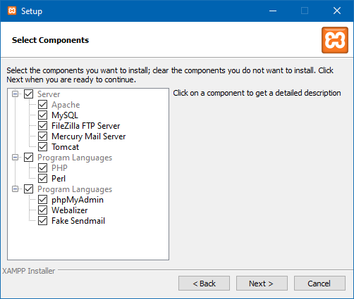
XAMPP, Cont.
I always just install all of the utilities. It’s about 750MB with everything, 650MB without the extras, and I’m going to delete them all when I’m done either way.

Slide 27
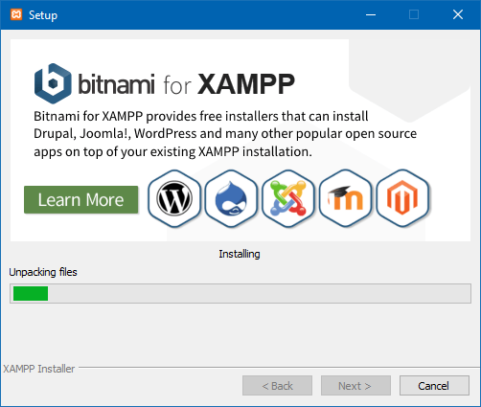
XAMPP, Cont.
I hate the current reliance on ads in every space. But they have to make money. Just a note that a common tactic is to stealth load various advertisers’ sites. Generally not a good, solid practice; it’s a warning sign about an app. But I, otherwise, haven’t seen any problems with XAMPP.
Either way, I’m loading this on a machine specifically for testing purposes, so if it turns out to be a security threat, I just need to wipe the machine.
You should have a machine specifically for testing purposes. Remember that last laptop you had, and you didn’t know what to do with it when you replaced it? That’s your sandbox computer.

Slide 28
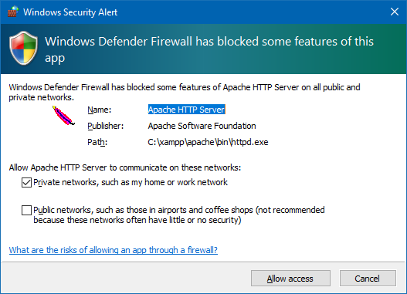
XAMPP, Cont.
We don’t need to give any of this access to the network.
This should not be our only security measure, but it’s one of the stronger ones.
The whole points of this setup is the ability to test client and server setups on one machine.

Slide 29
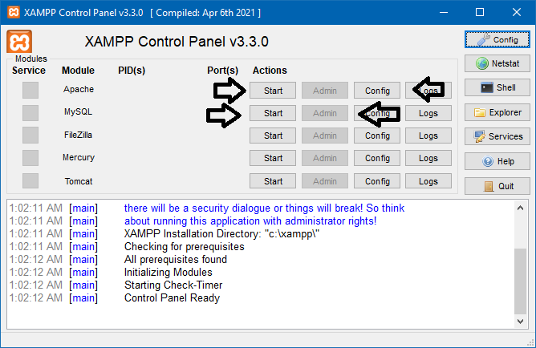
XAMPP, Cont.
Once XAMPP starts, we’re concerned primarily with the start/stop buttons for Apache and MySQL. These start/stop the servers gracefully.
We need the ‘config’ button for Apache to edit the httpd.conf and allow .py files to execute in python.
The MySQL Admin button will load phpMyAdmin, a web-based DBMS for MariaDB servers.

Slide 30
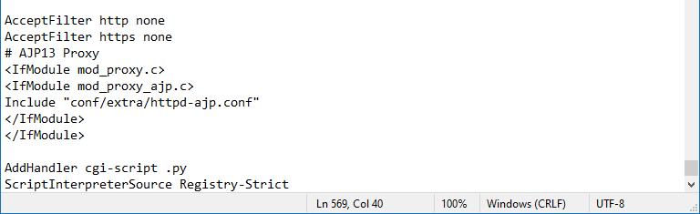
XAMPP, Cont.
We won’t get to this as much as I want, but it is a core function for any web dev we might do with python. So, let’s look at it.
Editting the httpd.conf file, we have a couple options. I find the easiest is to separate out the python stuff in case I want to disable it with #s later. Just put it at the bottom.
  This basically says ‘consider .py files to be scripts, but don’t use the default program, we’ll define it in each file’.
  (Actually, it says we’ll edit the registry and specify a separate script interpreting exe file for any given extension, but I’m not interested in editing the registry)

Slide 31
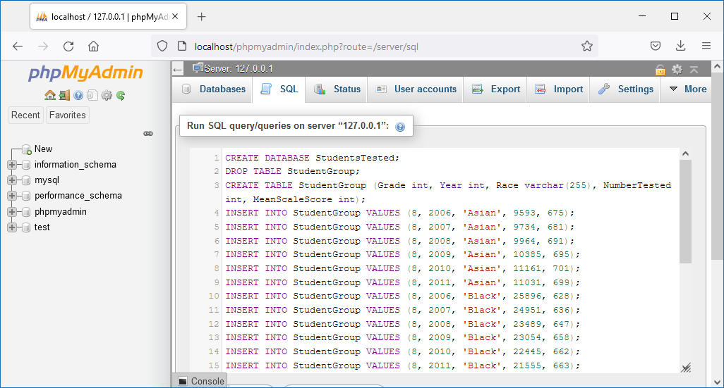
XAMPP, Data Load
When we click the ‘admin’ button for MySQL, we get this page.
This is a web interface. It’s Microsoft Access, but different. It’s more powerful and malleable, but about 75% more obnoxious to use.
Let’s jump into the SQL directly by clicking the ‘SQL’ tab, and pasting the results of our file writing python script

Slide 32
Data Load, Failure!
It will give us an error the first time we try: “Can’t drop table StudentGroups, table does not exist.”
It gives us a different error the second time we try: “Can’t create databases StudentsTested, database already exists.”
I was hoping I remembered that SQL was a non-blocking error generator. But any scripting error will crash us to desktop. This is a real problem, because we’ve got to get something produced, and we don’t have time to get into SQL Try…Catch blocks or SQL control statements.
Let’s create a quick and bad solution that makes me feel bad, but we’ll promise ourselves that some day we’ll come back and fix this to work better.
  There are lots of good solutions here. Ideally, we want a setup that will also not leave our DBMS littered with a confusing mess of old, outdated test results.

Slide 33
Python, Data Load Step 7
The problem is our process is:
  Create database, delete existing table, create table, populate table.
This is my preferred solution, but we’d need to handle the errors it creates. Let’s not delete the code, just comment it out.
New process is:
  Create the database and table manually.
  Empty the table, populate the table by code
# Construct SQL Query
# Skip 8 lines to avoid error. TODO: Generalize this code.
# sqlLines = ["CREATE DATABASE " + DatabaseName + ";\n"]
# sqlLines.append("DROP TABLE " + TableName +";\n")
# sqlLines.append("CREATE TABLE " + TableName + " ("
# + Attributes[0] + " int, "
# + Attributes[1] + " int, "
# + Attributes[2] + " varchar(255), "
# + Attributes[3] + " int, "
# + Attributes[4] + " int);\n")
sqlLines = ["TRUNCATE TABLE " + TableName + ";\n"]
# We could do this more efficiently with fewer insert statements, but this is clearer for now
for StudentGroup in xmlMatrix:
sqlLines.append("INSERT INTO StudentGroup VALUES ("
+ str(StudentGroup[0]) + ", "
+ str(StudentGroup[1]) + ", "
+ "\'" + StudentGroup[2] + "\', "
+ str(StudentGroup[3]) + ", "
+ str(StudentGroup[4]) + ");\n")
sqlFileHandle = open (sqlFileLocation, 'w')
sqlFileHandle.writelines(sqlLines)
sqlFileHandle.close()

Slide 34
SQL, Data Load Step 7
The new SQL output of our python script (which is the input to phpMyAdmin) is shown here.
TRUNCATE TABLE StudentGroup;
INSERT INTO StudentGroup VALUES (8, 2006, 'Asian', 9593, 675);
INSERT INTO StudentGroup VALUES (8, 2007, 'Asian', 9734, 681);
INSERT INTO StudentGroup VALUES (8, 2008, 'Asian', 9964, 691);
INSERT INTO StudentGroup VALUES (8, 2009, 'Asian', 10385, 695);
INSERT INTO StudentGroup VALUES (8, 2010, 'Asian', 11161, 701);
INSERT INTO StudentGroup VALUES (8, 2011, 'Asian', 11031, 699);
INSERT INTO StudentGroup VALUES (8, 2006, 'Black', 25896, 628);
INSERT INTO StudentGroup VALUES (8, 2007, 'Black', 24951, 636);
INSERT INTO StudentGroup VALUES (8, 2008, 'Black', 23489, 647);
INSERT INTO StudentGroup VALUES (8, 2009, 'Black', 23054, 658);
INSERT INTO StudentGroup VALUES (8, 2010, 'Black', 22445, 662);
INSERT INTO StudentGroup VALUES (8, 2011, 'Black', 21555, 663);
INSERT INTO StudentGroup VALUES (8, 2006, 'Hispanic', 29945, 631);
INSERT INTO StudentGroup VALUES (8, 2007, 'Hispanic', 29857, 639);
INSERT INTO StudentGroup VALUES (8, 2008, 'Hispanic', 28710, 651);
INSERT INTO StudentGroup VALUES (8, 2009, 'Hispanic', 28981, 662);
INSERT INTO StudentGroup VALUES (8, 2010, 'Hispanic', 28834, 665);
INSERT INTO StudentGroup VALUES (8, 2011, 'Hispanic', 28681, 667);
INSERT INTO StudentGroup VALUES (8, 2006, 'White', 10470, 660);
INSERT INTO StudentGroup VALUES (8, 2007, 'White', 9923, 666);
INSERT INTO StudentGroup VALUES (8, 2008, 'White', 9871, 676);
INSERT INTO StudentGroup VALUES (8, 2009, 'White', 9835, 683);
INSERT INTO StudentGroup VALUES (8, 2010, 'White', 9963, 687);
INSERT INTO StudentGroup VALUES (8, 2011, 'White', 9570, 688);

Slide 35
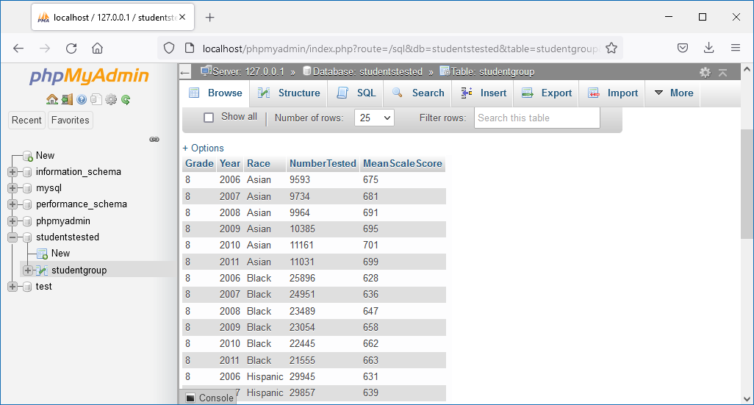
XAMPP, Data Load
Finally, we’ve got this data loaded into a live SQL server.
We can do something with it, now.
So far everything’s been very manual, and very hardcoded. Remember, this is like version 0.0.1alpha. We would iteratively increase the automation and functionality over time.

Slide 36
Presentation
So, the last stage is to produce a deliverable with it.
Let’s think for a moment about what we’re doing. At this point, you should be like ‘I could do everything so far, faster, prettier, and in tableau’, or something similar.
But, that relies on you doing everything. This is under the assumption that when people randomly send you data, they want you to do stuff for them and they’ll come back again later. It may just be faster and easier to produce a utility that will let them handle it on their own.
So, that’s ultimately our goal. Produce a quick web utility that lets them upload their file, have it auto-process, and then give them some basic manipulation tools.

Slide 37
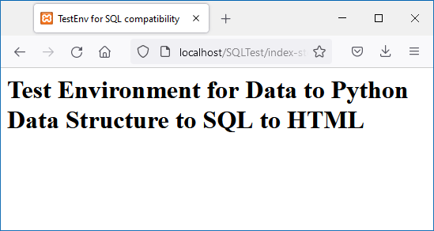
HTML, Presentation Step 8
A Basic HTML file.
I’m convinced you should learn HTML. Nothing says classy like being able to knock up a quick web page, throw it up on your web space, and send the link to a client within a few hours.
We’re going to create a folder ~xampp\htdocs\SQLTest
This is index.html, which is the page that will load if we go to http://localhost/SQLTest
If we had more time, we’d cover some quick CSS and tagging to make the page clean, the code simple, and increase functionality later.
  The third member of our programming triad is Javascript, but we won’t get there right here.
<HTML>
<HEAD>
<TITLE>
TestEnv for SQL compatibility
</TITLE>
</HEAD>
<BODY>
<H1> Test Environment for Data to Python Data Structure to SQL to HTML </H1>
</BODY>
</HTML>

Slide 38
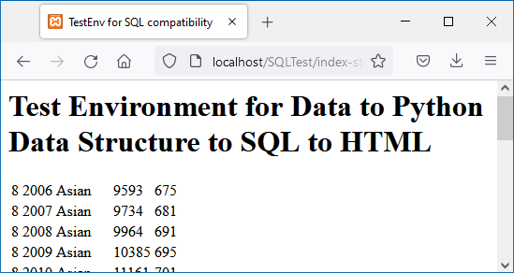
PHP, Presentation Step 9
We actually want it to dynamically do some things for us. That means we’ll use PHP, and change the file name to index.php. This is also a default file load for localhost/SQLTest
  PHP stands for Hypertext Pre Processor. Humourous Acronyms Are Humourous.
We can use PHP code to connect to that MariaDB database we just created and pull out the table we made.
Mysqli() is the function that will connect us to the server, we send it a basic SQL query, and then we print the results.
Mysqli() has some weirdnesses in its output. So we can’t dump the result to the canvas.
  Fetch_assoc() is the related function that handles mysqli()’s weird data structure. It just gives us each row of the database table in turn until there aren’t any left and then it gives a null, breaking the while loop.
  PHP was the first place I saw a foreach loop. I love them, you basically just say ‘do things the right way’.
<H1>…</H1>
<?php
// Connection Data
$srv = "localhost"; $usr = "root";
$pwd = ""; $db = "studentstested";
// Connect to the server, no password.
$con = new mysqli($srv, $usr, $pwd, $db);
// Our query right now is simple.
$qry = "SELECT * FROM studentgroup";
$out = $con->query($qry);
// Print the output data to the screen.
echo "<TABLE>\n";
while ($row = $out->fetch_assoc())
{
echo "<TR>\n";
foreach ($row as $dat)
{
echo "<TD>";
echo $dat;
echo "</TD>\n";
}
echo "</TR>\n";
}
echo "</TABLE>\n";
?>
</BODY>
</HTML>

Slide 39
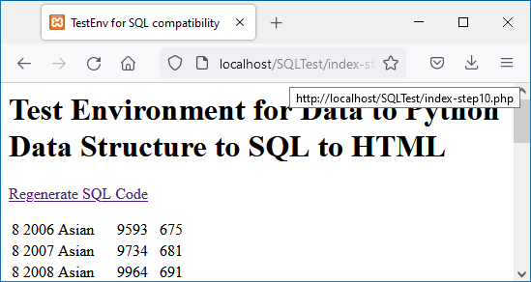
PHP/Python, Presentation Step 10
A last step, as a nod to interactivity and automation, let’s give the user a chance to automatically generate the sql file.
  Of course, we haven’t automated the process of .sql file being imported into MariaDB. It’s one of the first bits I’d address.
Also, note that I forgot to close the connection to the MariaDB server. Whoops!
<HTML>
<HEAD>
<TITLE>
TestEnv for SQL compatibility
</TITLE>
</HEAD>
<BODY>
<H1> Test Environment for Data to Python Data Structure to SQL to HTML </H1>
<p><a href=".\PsuedoXMLParser.py">Regenerate SQL Code</a></p>
<?php
// Connection Data
$srv = "localhost";
$usr = "root";
$pwd = ""; // set in MariaDB my.ini, but no password by default
$db = "studentstested";

Slide 40
Where to go from here?
This is a lot of steps for not much of a result. But, we’re basically touching a piece of technology on every level of the Analytics function.
Automate python -> phpMyAdmin.
  We need to include some packages to do this. I didn’t want to deal with packages for this project.
  That’s not true, we can do it with straight sockets and bit manipulation over IP, but that’s probably a couple weeks of figuring out how to do that for a low-impact application, solving a problem that’s already been solved with packages. Still a good learning exercise.
Dynamism in the SQL.
  We need the SQL to be not hardcoded. That means we’ll need to make sure we delete any databases we create when we’re done (or could we switch to a client-facing SQLite-style implementation?) and heuristically identifying database names, table names, and attribute names.
  Likely that would involve pre-scanning the input stream for <>’s and then creating a list of unique elements. We’d also need a counter to figure out what level of the hierarchy we’re on.
  Also, there’s a whole XML package we could import that would likely do a lot of this for us automatically.

Slide 41
Where to go from here?, Cont.
User -> python
  At some point, it would be good to let the user upload their own file directly to the website and then have the python script run on that file.
  The moment we allow freeform user submission, we need to get our InfoSec down. We need to be sure we’ve addressed every security issue, handled every possible crash point, etc.
    Likely, I would start over from scratch, and line by line make sure I’ve checked for security vulnerabilities.
  We need to be confident in our security precautions before we begin this stage and at every minor milestone.
Dynamic table
  We’d like the resulting table to be dynamic. That is, the user should be able to change the order, do some filtering, grouping, etc.
  Likely client-side in JS? But an argument could be made that it’s just as simple to use the SQL server to do some of this.
Simple analysis
  We’d like the table to produce some basic graphs. 1-factor and 2-factor analyses, etc.
  I, personally, like R’s graphing packages. But adding another language into the mix is Ozymandian hubris. However, it would allow for some bulk automation on the variations of possible graphing types presented.
  More likely, Javascript is the easier solution since it can paint things right onto the canvas.

Slide 42
Where to go from here?, Cont.
Security-wise, this project is messy. Security is listed last here, but it should really be one of the first things we consider, and we should always be programming in a security-conscious fashion. Two possibilities:
  This project would never, ever leave a sandbox environment in which case it might be ok to just consistently skimp on security, although that also leads to sloppy habits
  This point right here (step 10 above) is about as far as I’d go before I started implementing security issues. The issue isn’t whether someone can access the data in our app so much as it is whether they can use our poorly designed app to bridgehead into other, more sensitive systems.

Slide 43
Pedagogy from Here
Assignments would be some variation of ‘do the same thing on your own, but slightly different’, for example, they’d get a rogue JSON file.
Or, we’d all start at about step 10 above, and they’d be responsible for implementing the various stages of ‘Next Steps’ above.
Or, if it was a class for a specific language, stage-by-stage, I’d provide ‘what the rest of the development team put together’ and they’d be responsible for responding with the portion in their language.

